Slide 1

Slide 1
SAS COUPON
-Project of Data Science-

Slide 2
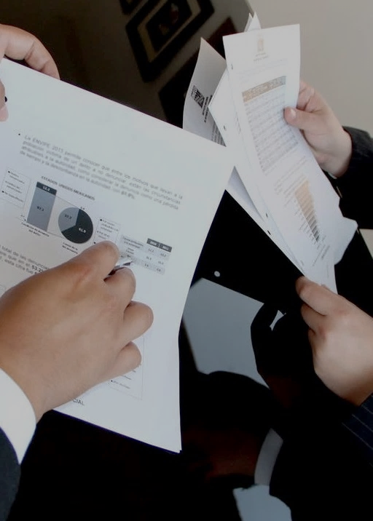
Slide 6
What is this data?
A survey done by Amazon Mechanical Turk. as to when do drivers (under different scenarios) accept a coupon offered to them

Slide 3
Why this dataset?
Help advertisers know the optimal conditions under which to distribute their coupons.
Help business owners know what demography to expect to use their promotions.
Help people receive the optimal coupons in the optimal conditions

Slide 4
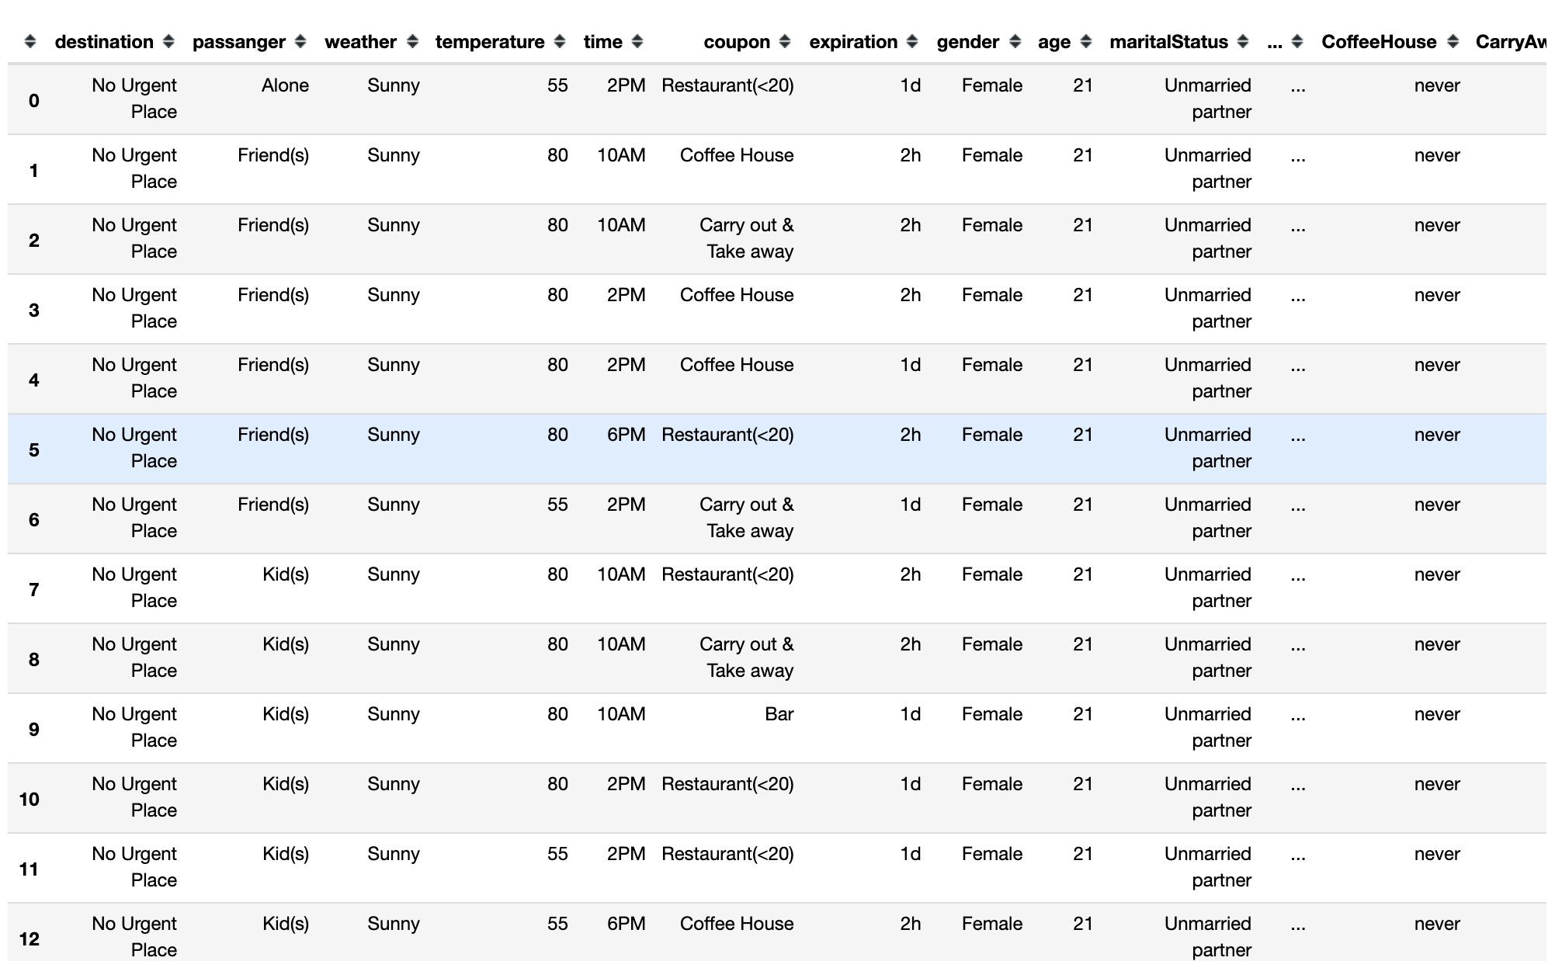
Our dataset
Shape of Dataset
This data studies whether a person will accept the coupon recommended to him in different driving scenarios.
Numbers of records
12684
Number of features
23
Missing value
13,370/291,732
Notes:
This data was collected via a survey on Amazon Mechanical Turk. The survey describes different driving scenarios including the destination, current time, weather, passenger, etc., and then ask the person whether he will accept the coupon if he is the driver.

Slide 5
Exploring the dataset:

Slide 6
Features
destination | passenger | weather | temperature | time | coupon | expiration | gender | age | maritalStatus
No Urgent Place | Alone | Sunny | 55 | 7AM | Restaurant(<$20) | 1d | Female | below21 | Unmarried partner
Home | Friend(s) | Rainy | 80 | 10AM | Restaurant($20-$50 | 2h | Male | 26 | Single
Work | Kid(s) | Snowy | 30 | 2PM | Coffee House |  |  | 36 | Married partner
 | Partner |  |  | 6PM | Bar |  |  | 46 | Divorced
 |  |  |  | 10PM | Carry out & Take away |  |  | 50plus | Widowed

Slide 7
Features
education | occupation | income | Bar | CoffeeHouse | CarryAway | RestaurantLessThan20 | Restaurant20To50 | toCoupon_GEQ15min | toCoupon_GEQ25min
Some college - no degree | Unemployed | Less than $12500 | never | never | never | never | never | never | never
Bachelors degree | Student | $12500 - $24999, | less1 | less1 | less1 | less1 | less1 | less1 | less1
Associates degree | Architecture & Engineering | $50000 - $62499, | 1~3 | 1~3 | 1~3 | 1~3 | 1~3 | 1~3 | 1~3
High School Graduate, | Business & Financial | $62500 - $74999, | 4~8 | 4~8 | 4~8 | 4~8 | 4~8 | 4~8 | 4~8
…………. | ……….. | ………. | gt8 | gt8 | gt8 | gt8 | gt8 | gt8 | gt8
Notes:
Bar (feature meaning: how many times do you go to a bar every month?)
CoffeeHouse (feature meaning: how many times do you go to a coffeehouse every month?)
CarryAway (feature meaning: how many times do you get take-away food every month?)
RestaurantLessThan20: (feature meaning: how many times do you go to a restaurant with an average expense per person of less than $20 every month?)
Restaurant20To50: (feature meaning: how many times do you go to a restaurant with average expense per person of $20 - $50 every month?)
toCoupon_GEQ15min: feature meaning: driving distance to the restaurant/bar for using the coupon is greater than 15 minutes)
toCoupon_GEQ25min: (feature meaning: driving distance to the restaurant/bar for using the coupon is greater than 25 minutes)
direction_same: (feature meaning: whether the restaurant/bar is in the same direction as your current destination)
direction_opp: (feature meaning: whether the restaurant/bar is in the same direction as your current destination)

Slide 8
Pre-Processing:

Slide 9
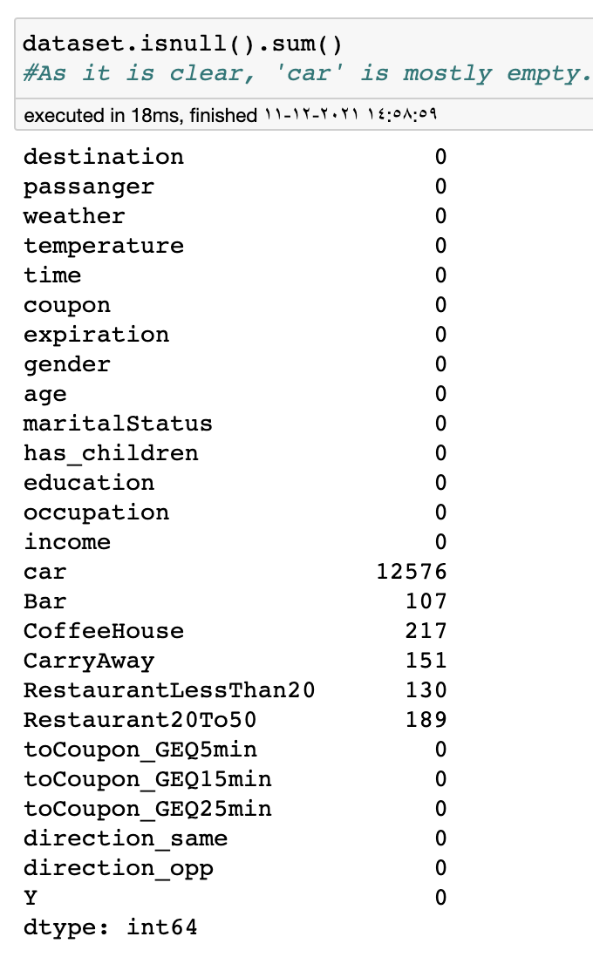
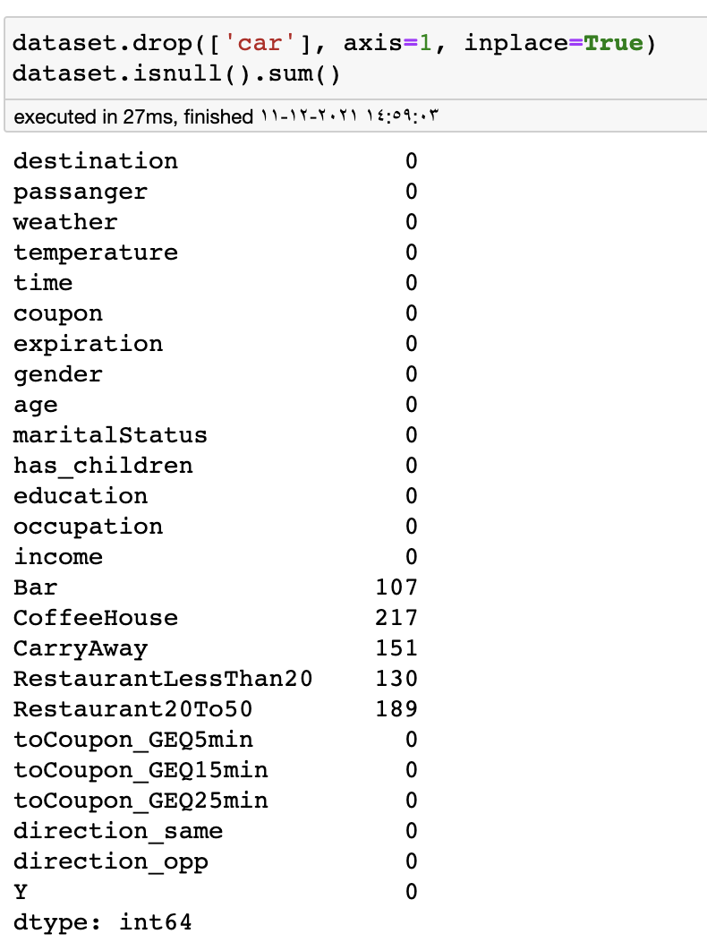
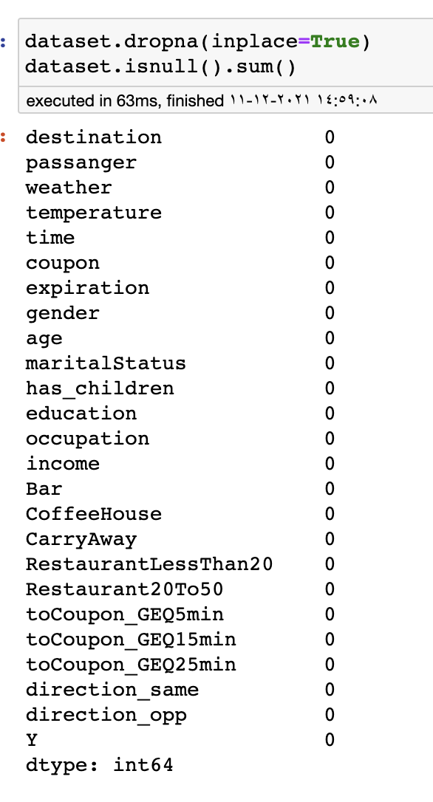
Pre-Processing
Upcoming Deposits
$704.78
$191.01
$189.31
$186.54
Showing the missing values
Drop (car) feature
Drop any record with missing value

Slide 10
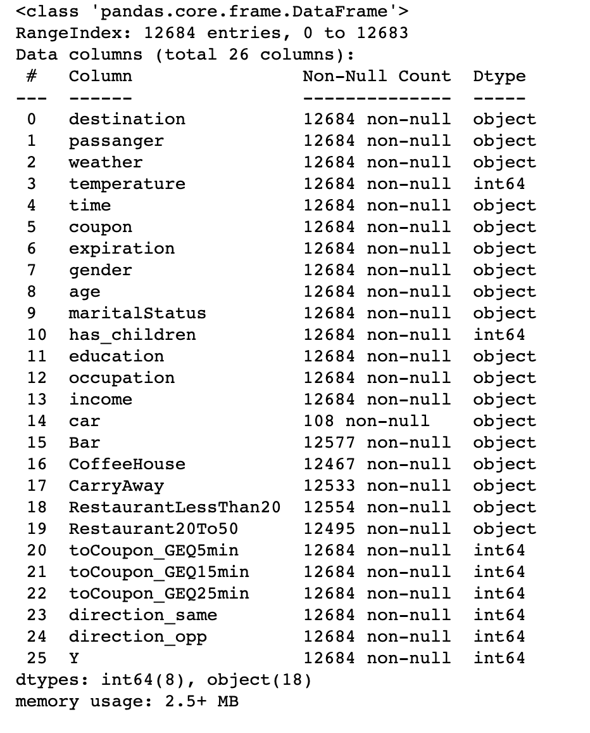
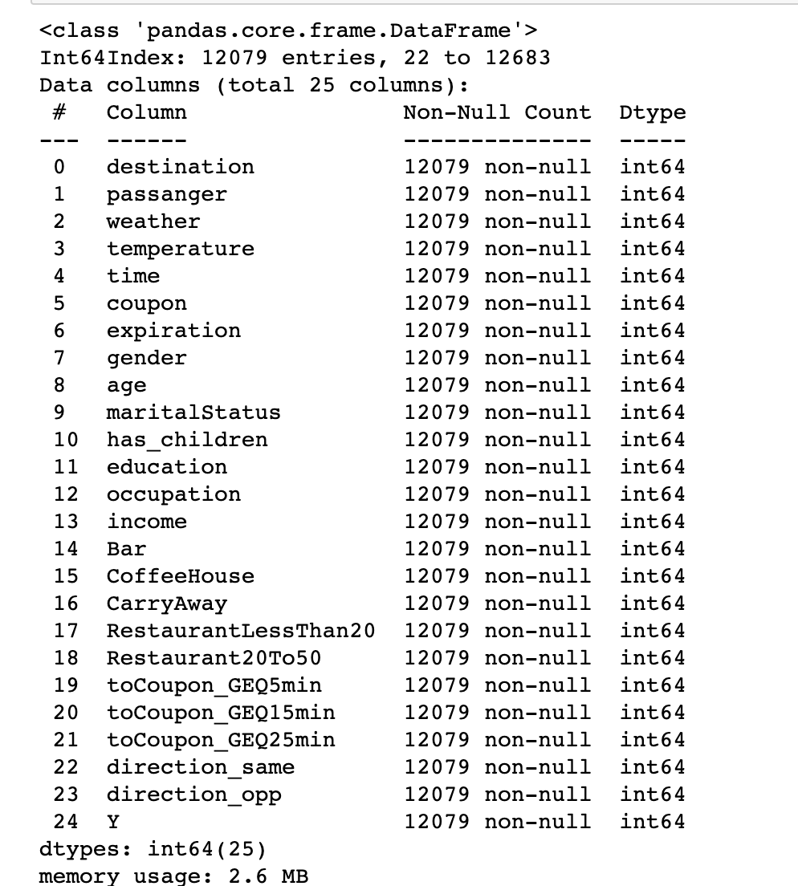
Pre-Processing
Upcoming Deposits
$704.78
$191.01
$189.31
$186.54
Most data type of features object !!!
Now looks fine ☺

Slide 11
visualization :

Slide 12
visualization
Attached in the image file

Slide 13
Modeling:

Slide 14
First:
KNN
Splitting
Cross-Validation

Slide 15
MANY VARIABLES
Features x1-23
Normalization x2
Splitting
X0-100
-- AND --
CV
X1-10..
K-Neighbors x1-40..
Weight
x2

Slide 16
MANY VARIABLES
Features x1-23
Normalization x2
Splitting
X0-100
-- AND --
CV
X1-10..
K-Neighbors x1-40..
Weight
x2

Slide 17
Master Algorithm
Foreach Feature (1-23; BFE)
Foreach neighbor (1-40)
Foreach Weight (‘Uniform’, ‘Distance’)
Foreach split range (1-90)
Foreach Normalization (True, False)
Foreach CV (1-10)

Slide 18
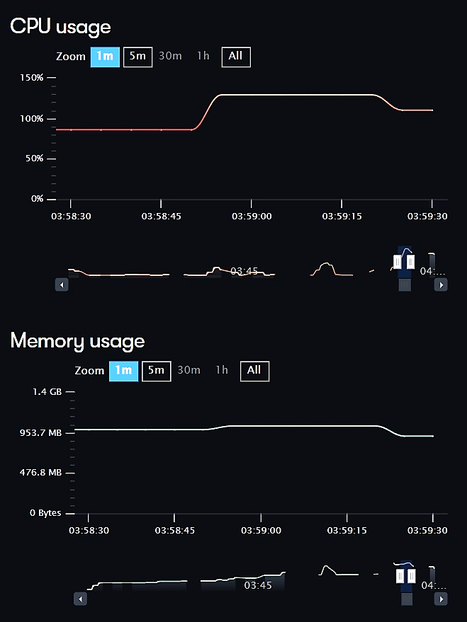
Cloud Computation:

Slide 19
Simplified version:
Foreach Feature (1-23; BFE)
Foreach neighbor (1-40)
Foreach split range (20-80:20)
Foreach CV (1-10)

Slide 20
Results:

Slide 21
KNN-Classifier
33
71%
80%
K-neighbors
Accuracy
Split
Features:
‘destination', 'passanger', 'weather', 'coupon', 'expiration', 'education', 'income', 'Bar’, 'CoffeeHouse', 'CarryAway', 'RestaurantLessThan20', 'toCoupon_GEQ25min', 'direction_same', 'direction_opp'

Slide 22
Experiment: KNN-regressor

Slide 23
KNN-regressor Cross-validated
Accuracy plummeted to 15%!

Slide 24
Second:
Random Forest

Slide 25
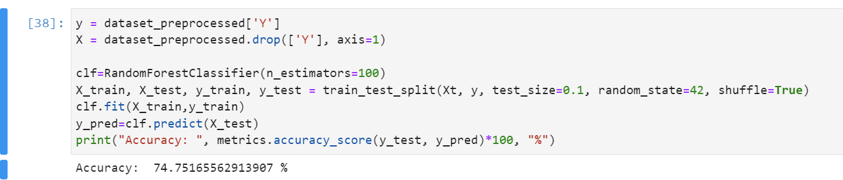
Random Forest
Right off the bat:

Slide 26
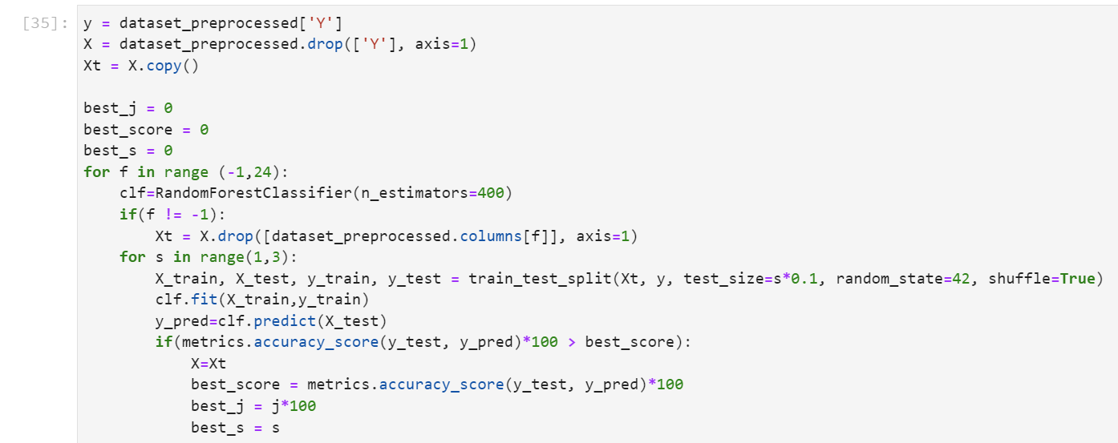
Random forest
77%
Accuracy
'passanger', 'time', 'coupon', 'expiration', 'education', 'occupation', 'income', 'Bar’,
'CoffeeHouse', 'CarryAway', 'RestaurantLessThan20', 'Restaurant20To50', 'toCoupon_GEQ5min’,
'toCoupon_GEQ15min', 'toCoupon_GEQ25min', 'direction_same'
Features:

Slide 27
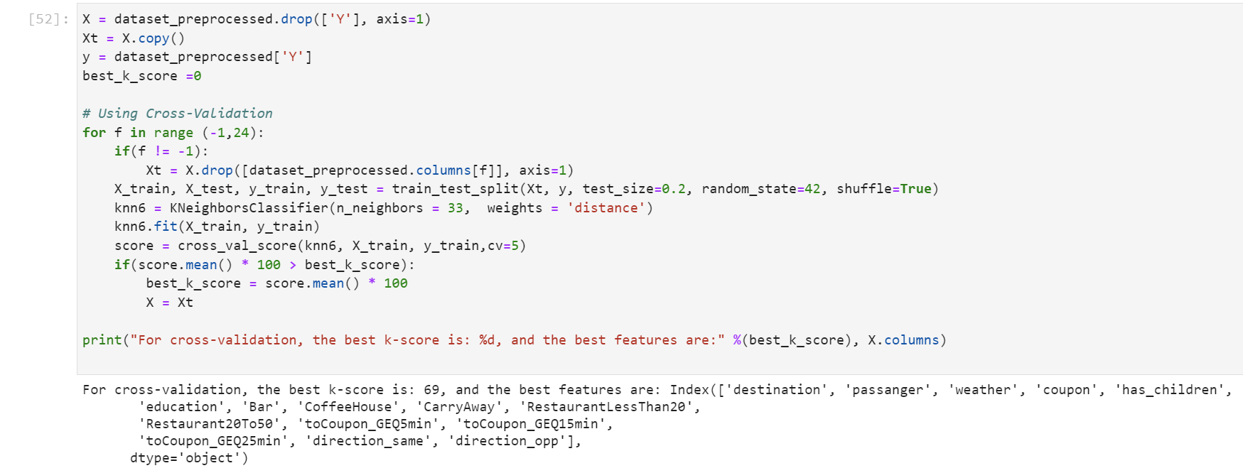
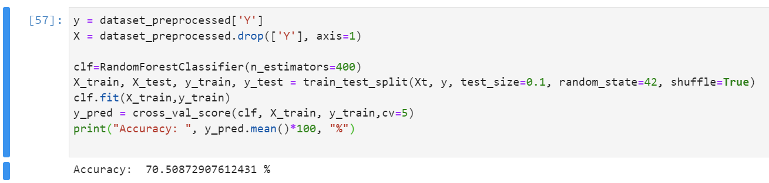
Final results cross-validated:
KNN classifier:
69%
Random forest:
70.5%

Slide 28
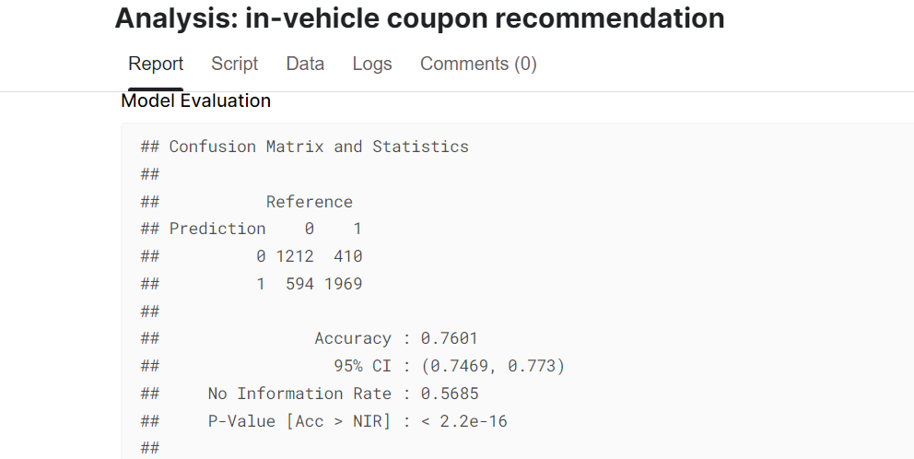
Other work:
We found a research that modeled the same data using R language and various models got a very similar results
Random Forest

Slide 29
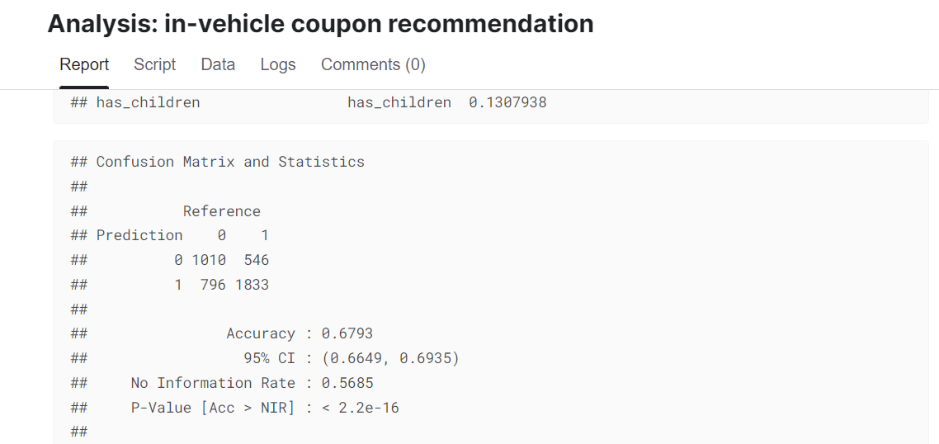
Other work:
We found a research that modeled the same data using R language and various models got a very similar results
After cross validation

Slide 30

Slide 10
THANK YOU

Slide 31
Slide 10
References:
Wang, Tong, Cynthia Rudin, Finale Doshi-Velez, Yimin Liu, Erica Klampfl, and Perry MacNeille. 'A bayesian framework for learning rule sets for interpretable classification.' The Journal of Machine Learning Research 18, no. 1 (2017): 2357-2393.
https://archive.ics.uci.edu/ml/datasets/in-vehicle+coupon+recommendation
The research about the same data
https://www.kaggle.com/rijinbaby/analysis-in-vehicle-coupon-recommendation/report#random-forest

Slide 32
Slide 10
Team member:
Sattam Alammar 218110372
Serry Al sibaee 218110246
Abdulaziz Mohamaden 218110098

